Slide 1
CSE 321 Computer Networks July 2018 Term
Class 17-19: Reliable Data Transfer
Khaled Mahmud Shahriar
Assistant Professor, Dept. of CSE, BUET khaledshahriar@cse.buet.ac.bd

Slide 2


Chapter 3 Transport Layer
Computer Networking: A Top Down Approach 6th edition Jim Kurose, Keith Ross Addison-Wesley March 2012
A note on the use of these ppt slides:
We’re making these slides freely available to all (faculty, students, readers). They’re in PowerPoint form so you see the animations; and can add, modify, and delete slides (including this one) and slide content to suit your needs. They obviously represent a lot of work on our part. In return for use, we only ask the following:
If you use these slides (e.g., in a class) that you mention their source (after all, we’d like people to use our book!)
If you post any slides on a www site, that you note that they are adapted from (or perhaps identical to) our slides, and note our copyright of this material.
Thanks and enjoy! JFK/KWR
All material copyright 1996-2012
J.F Kurose and K.W. Ross, All Rights Reserved

Slide 3
Chapter 3 outline
3.1 transport-layer services
3.2 multiplexing and demultiplexing
3.3 connectionless transport: UDP
3.4 principles of reliable data transfer
3.5 connection-oriented transport: TCP
segment structure
reliable data transfer
flow control
connection management
3.6 principles of congestion control
3.7 TCP congestion control

Slide 4
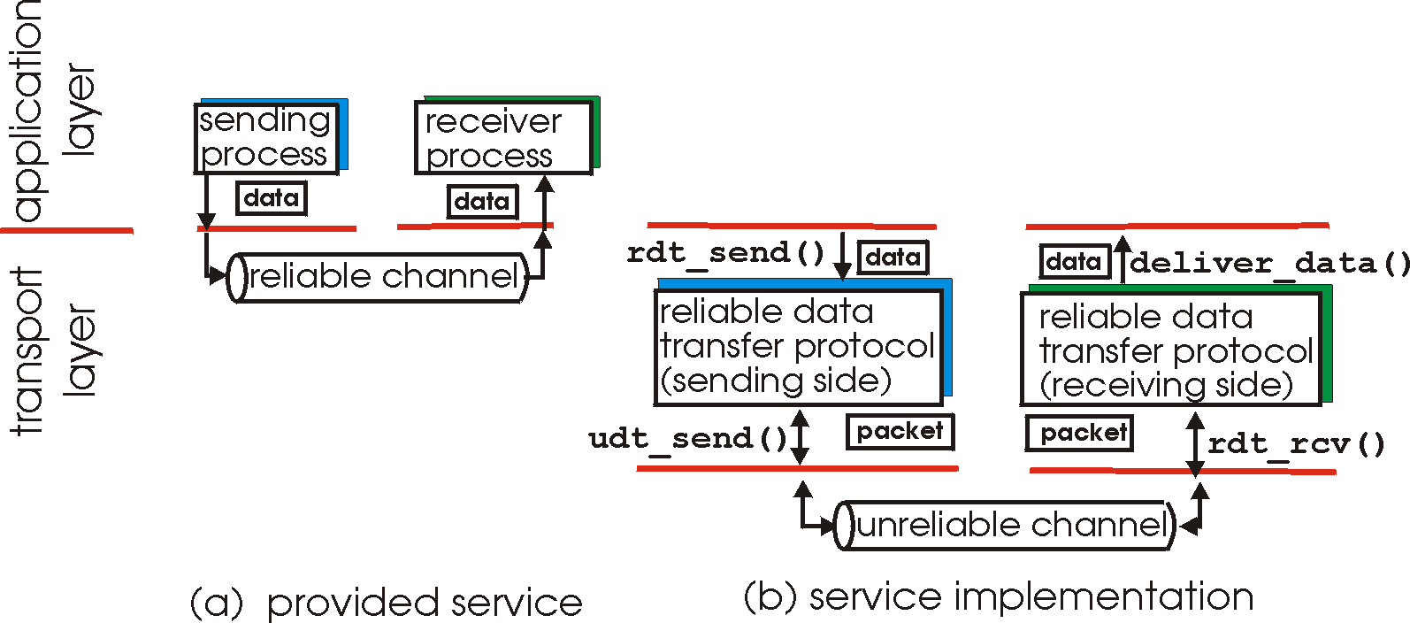
Principles of reliable data transfer
important in application, transport, link layers
top-10 list of important networking topics!
characteristics of unreliable channel will determine complexity of reliable data transfer protocol (rdt)

Slide 5
Principles of reliable data transfer
important in application, transport, link layers
top-10 list of important networking topics!
characteristics of unreliable channel will determine complexity of reliable data transfer protocol (rdt)

Slide 6
Principles of reliable data transfer
important in application, transport, link layers
top-10 list of important networking topics!
characteristics of unreliable channel will determine complexity of reliable data transfer protocol (rdt)

Slide 7
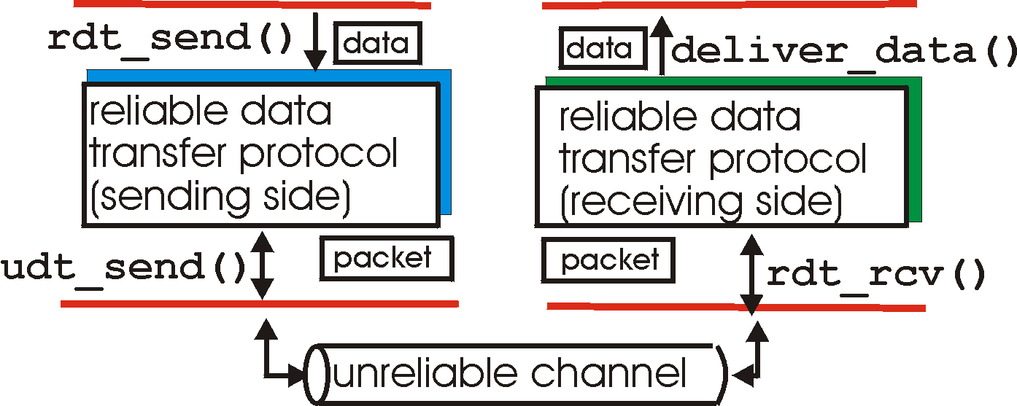
Reliable data transfer: getting started
rdt_send(): called from above, (e.g., by app.). Passed data to
deliver to receiver upper layer
deliver_data(): called by rdt to deliver data to upper
send
side
receive
side
udt_send(): called by rdt,
to transfer packet over
unreliable channel to receiver
rdt_rcv(): called when packet arrives on rcv-side of channel

Slide 8
Characteristics of Channel
Packet may get corrupted due to noise, device error etc. but always reaches the receiver
Packets may get lost in transit
Packets may be reordered
problem of delayed duplicate
Notes:
A channel that does not reorder means: if PKT1 is sent before PKT2, either PKT1 will be received before PKT2 or not received at all

Slide 9
Reliable data transfer: getting started
we’ll:
incrementally develop sender, receiver sides of reliable data transfer protocol (rdt)
consider only unidirectional data transfer
but control info will flow on both directions!
use finite state machines (FSM) to specify sender, receiver
event causing state transition
actions taken on state transition
state: when in this “state” next state uniquely determined by next event
state
1
state
2
event
actions

Slide 10
rdt1.0: reliable transfer over a reliable channel
underlying channel perfectly reliable
no bit errors
no loss of packets
separate FSMs for sender, receiver:
sender sends data into underlying channel
receiver reads data from underlying channel
sender
receiver
send pkt
pkt
send pkt
rcv pkt
pkt
send pkt
rcv pkt
pkt
send pkt
pkt
rcv pkt
send pkt
rcv pkt
pkt
send pkt
rcv pkt
pkt
rcv pkt
rdt_send(data)
Wait for call from below
rdt_rcv(packet)
Wait for call from above
packet = make_pkt(data)
udt_send(packet)
extract (packet,data)
deliver_data(data)
sender
receiver

Slide 11
rdt2.0: channel with bit errors
underlying channel may flip bits in packet
checksum to detect bit errors
the question: how to recover from errors:
acknowledgements (ACKs): receiver explicitly tells sender that pkt received OK
negative acknowledgements (NAKs): receiver explicitly tells sender that pkt had errors
sender retransmits pkt on receipt of NAK
new mechanisms in rdt2.0 (beyond rdt1.0):
error detection
receiver feedback: control msgs (ACK,NAK) rcvr->sender
How do humans recover from “errors”
during conversation?

Slide 12
rdt2.0: channel with bit errors
underlying channel may flip bits in packet
checksum to detect bit errors
the question: how to recover from errors:
acknowledgements (ACKs): receiver explicitly tells sender that pkt received OK
negative acknowledgements (NAKs): receiver explicitly tells sender that pkt had errors
sender retransmits pkt on receipt of NAK
new mechanisms in rdt2.0 (beyond rdt1.0):
error detection
feedback: control msgs (ACK,NAK) from receiver to sender

Slide 13
rdt2.0 in action space-time diagram
sender
receiver
send pkt
pkt
rcv pkt
ack
send ack
rcv ack
pkt
send pkt
error
rcv corrupted packet
NAK
send NAK
rcv NAK
resend pkt
pkt
rcv pkt
ack
send ack
rcv ack
send pkt
pkt
stop and wait
rcv pkt
ack
send ack
sender sends one packet,
then waits for receiver
response
rcv ack

Slide 14
rdt2.0: FSM specification
rdt_send(data)
sndpkt = make_pkt(data, checksum)
udt_send(sndpkt)
receiver
rdt_rcv(rcvpkt) &&
isNAK(rcvpkt)
Wait for call from above
Wait for ACK or NAK
rdt_rcv(rcvpkt) &&
corrupt(rcvpkt)
udt_send(sndpkt)
udt_send(NAK)
rdt_rcv(rcvpkt) && isACK(rcvpkt)
Λ
Wait for call from below
sender
rdt_rcv(rcvpkt) &&
notcorrupt(rcvpkt)
extract(rcvpkt,data)
deliver_data(data)
udt_send(ACK)

Slide 15
rdt2.0: operation with no errors
rdt_send(data)
snkpkt = make_pkt(data, checksum)
udt_send(sndpkt)
rdt_rcv(rcvpkt) &&
isNAK(rcvpkt)
Wait for call from above
Wait for ACK or NAK
rdt_rcv(rcvpkt) &&
corrupt(rcvpkt)
udt_send(sndpkt)
udt_send(NAK)
rdt_rcv(rcvpkt) && isACK(rcvpkt)
Wait for call from below
Λ
rdt_rcv(rcvpkt) &&
notcorrupt(rcvpkt)
extract(rcvpkt,data)
deliver_data(data)
udt_send(ACK)

Slide 16
rdt2.0: error scenario
rdt_send(data)
snkpkt = make_pkt(data, checksum)
udt_send(sndpkt)
rdt_rcv(rcvpkt) &&
isNAK(rcvpkt)
Wait for call from above
Wait for ACK or NAK
rdt_rcv(rcvpkt) &&
corrupt(rcvpkt)
udt_send(sndpkt)
udt_send(NAK)
rdt_rcv(rcvpkt) && isACK(rcvpkt)
Wait for call from below
Λ
rdt_rcv(rcvpkt) &&
notcorrupt(rcvpkt)
extract(rcvpkt,data)
deliver_data(data)
udt_send(ACK)

Slide 17
rdt2.0 has a fatal flaw!
sender
receiver
what happens if ACK/NAK corrupted?
sender doesn’t know what happened at receiver!
can’t just retransmit: possible duplicate
send pkt
pkt
rcv pkt
ack
send ack
rcv ack
pkt
send pkt
error
rcv corrupted packet
rcv corrupted pkt
what was it ?
ACK or NAK!!
NAK
send NAK
handling duplicates:
sender retransmits current pkt if ACK/NAK corrupted
sender adds sequence number to each pkt
receiver discards (doesn’t deliver up) duplicate pkt

Slide 18
rdt2.1: Frames with Seq No.
sender
receiver
seq expected
send pkt
pkt0
rcv pkt
0
ack
send ack
rcv ack
send pkt
pkt1
ack
rcv packet
1
rcv corrupted pkt
resend packet
send ack
error
pkt1
packet already rcvd;
discard
0
ack
send ack
rcv nak
send pkt
pkt0
rcv packet
0
ack0
send ack
rcv ack

Slide 19
rdt2.1: sender, handles garbled ACK/NAKs
rdt_send(data)
sndpkt = make_pkt(0, data, checksum)
udt_send(sndpkt)
rdt_rcv(rcvpkt) &&
( corrupt(rcvpkt) ||
isNAK(rcvpkt) )
Wait for call 0 from above
Wait for ACK or NAK 0
udt_send(sndpkt)
rdt_rcv(rcvpkt)
&& notcorrupt(rcvpkt)
&& isACK(rcvpkt)
rdt_rcv(rcvpkt)
&& notcorrupt(rcvpkt)
&& isACK(rcvpkt)
Λ
Λ
Wait for ACK or NAK 1
Wait for
call 1 from above
rdt_rcv(rcvpkt) &&
( corrupt(rcvpkt) ||
isNAK(rcvpkt) )
rdt_send(data)
udt_send(sndpkt)
sndpkt = make_pkt(1, data, checksum)
udt_send(sndpkt)

Slide 20
rdt2.1: receiver, handles garbled ACK/NAKs
rdt_rcv(rcvpkt) && notcorrupt(rcvpkt)
&& has_seq0(rcvpkt)
extract(rcvpkt,data)
deliver_data(data)
sndpkt = make_pkt(ACK, chksum)
udt_send(sndpkt)
rdt_rcv(rcvpkt) && (corrupt(rcvpkt)
rdt_rcv(rcvpkt) && (corrupt(rcvpkt)
sndpkt = make_pkt(NAK, chksum)
udt_send(sndpkt)
sndpkt = make_pkt(NAK, chksum)
udt_send(sndpkt)
Wait for
0 from below
Wait for
1 from below
rdt_rcv(rcvpkt) &&
not corrupt(rcvpkt) &&
has_seq1(rcvpkt)
rdt_rcv(rcvpkt) &&
not corrupt(rcvpkt) &&
has_seq0(rcvpkt)
sndpkt = make_pkt(ACK, chksum)
udt_send(sndpkt)
sndpkt = make_pkt(ACK, chksum)
udt_send(sndpkt)
rdt_rcv(rcvpkt) && notcorrupt(rcvpkt)
&& has_seq1(rcvpkt)
extract(rcvpkt,data)
deliver_data(data)
sndpkt = make_pkt(ACK, chksum)
udt_send(sndpkt)

Slide 21
rdt2.1: discussion
sender:
seq # added to pkt
two seq. #’s (0,1) will suffice. Why?
must check if received ACK/NAK corrupted
twice as many states
state must “remember” whether “expected” pkt should have seq # of 0 or 1
receiver:
must check if received packet is duplicate
state indicates whether 0 or 1 is expected pkt seq #
note: receiver can not know if its last ACK/NAK received OK at sender

Slide 22
rdt2.2: a NAK-free protocol
same functionality as rdt2.1, using ACKs only
instead of NAK, receiver sends ACK for last pkt received OK
receiver must explicitly include seq # of pkt being ACKed
duplicate ACK at sender results in same action as NAK: retransmit current pkt

Slide 23
rdt2.1: No NAK
sender
receiver
seq expected
ack expected
send pkt
pkt0
rcv pkt
0
ack0
send ack
0
rcv ack
send pkt
pkt1
error
rcv corrupted packet
1
ack0
send ack (no nak)
1
rcv ack; not expected
resend packet
pkt1
packet already rcvd;
discard
0
ack1
send ack
1
rcv nak
send pkt
pkt0
rcv packet
0
ack0
send ack
0
rcv ack

Slide 24
rdt2.2: sender, receiver fragments
rdt_send(data)
sndpkt = make_pkt(0, data, checksum)
udt_send(sndpkt)
rdt_rcv(rcvpkt) &&
( corrupt(rcvpkt) ||
isACK(rcvpkt,1) )
Wait for call 0 from above
Wait for ACK
0
udt_send(sndpkt)
sender FSM
fragment
rdt_rcv(rcvpkt)
&& notcorrupt(rcvpkt)
&& isACK(rcvpkt,0)
rdt_rcv(rcvpkt) &&
(corrupt(rcvpkt) ||
has_seq1(rcvpkt))
Λ
Wait for
0 from below
receiver FSM
fragment
udt_send(sndpkt)
rdt_rcv(rcvpkt) && notcorrupt(rcvpkt)
&& has_seq1(rcvpkt)
extract(rcvpkt,data)
deliver_data(data)
sndpkt = make_pkt(ACK1, chksum)
udt_send(sndpkt)

Slide 25
rdt3.0: channels with errors and loss
new assumption: underlying channel can also lose packets (data, ACKs)
checksum, seq. #, ACKs, retransmissions will be of help … but not enough
approach: sender waits “reasonable” amount of time for ACK
retransmits if no ACK received in this time
if pkt (or ACK) just delayed (not lost):
retransmission will be duplicate, but seq. #’s already handles this
receiver must specify seq # of pkt being ACKed
requires countdown timer
Also known as alternating-bit protocol

Slide 26
rdt3.0 sender
rdt_send(data)
rdt_rcv(rcvpkt) &&
( corrupt(rcvpkt) ||
isACK(rcvpkt,1) )
sndpkt = make_pkt(0, data, checksum)
udt_send(sndpkt)
start_timer
rdt_rcv(rcvpkt)
Λ
Λ
Wait for
call 0from above
Wait for ACK0
timeout
udt_send(sndpkt)
start_timer
rdt_rcv(rcvpkt)
&& notcorrupt(rcvpkt)
&& isACK(rcvpkt,1)
rdt_rcv(rcvpkt)
&& notcorrupt(rcvpkt)
&& isACK(rcvpkt,0)
stop_timer
stop_timer
Wait for ACK1
Wait for
call 1 from above
timeout
udt_send(sndpkt)
start_timer
rdt_rcv(rcvpkt)
rdt_send(data)
Λ
rdt_rcv(rcvpkt) &&
( corrupt(rcvpkt) ||
isACK(rcvpkt,0) )
sndpkt = make_pkt(1, data, checksum)
udt_send(sndpkt)
start_timer
Λ

Slide 27

rdt3.0 in action
sender
receiver
sender
receiver
send pkt0
pkt0
send pkt0
pkt0
rcv pkt0
rcv pkt0
ack0
send ack0
ack0
send ack0
rcv ack0
rcv ack0
send pkt1
pkt1
send pkt1
pkt1
rcv pkt1
X
ack1
send ack1
loss
rcv ack1
send pkt0
pkt0
rcv pkt0
timeout
resend pkt1
ack0
send ack0
pkt1
rcv pkt1
ack1
send ack1
rcv ack1
send pkt0
pkt0
(a) no loss
rcv pkt0
ack0
send ack0
(b) packet loss

Slide 28
rdt3.0 in action
sender
receiver
sender
receiver
send pkt0
pkt0
send pkt0
pkt0
rcv pkt0
rcv pkt0
ack0
send ack0
send ack0
rcv ack0
ack0
send pkt1
pkt1
rcv ack0
rcv pkt1
send pkt1
pkt1
send ack1
rcv pkt1
ack1
send ack1
ack1
X
loss
timeout
resend pkt1
pkt1
rcv pkt1
timeout
resend pkt1
rcv ack1
pkt1
rcv pkt1
pkt0
(detect duplicate)
send pkt0
send ack1
ack1
(detect duplicate)
ack1
rcv pkt0
rcv ack1
send ack1
rcv ack1
ack0
send ack0
pkt0
send pkt0
pkt0
send pkt0
rcv pkt0
rcv pkt0
ack0
(detect duplicate)
ack0
send ack0
send ack0
(c) ACK loss
(d) premature timeout/ delayed ACK

Slide 29
Determining the Value of Timeout
Must be as long as the round-trip time (RTT) between the sender and receiver
Easy for point to point link
Difficult to compute end to end; need to consider
buffering at intermediate routers
time needed to process packet at each hop
Waiting for worst case maximum delay would degrade performance
Determined dynamically as in TCP

Slide 30
Performance of rdt3.0
rdt3.0 is correct, but performance stinks
e.g.: 1 Gbps link, 15 ms prop. delay, 8000 bit packet:
L
8000 bits
D_{trans} =
=
=
8 microsecs
R
10⁹ bits/sec
U _{sender}: utilization – fraction of time sender busy sending
if RTT=30 msec, 1KB pkt every 30 msec: 33kB/sec thruput over 1 Gbps link
network protocol limits use of physical resources!

Slide 31
rdt3.0: stop-and-wait operation
sender
receiver
first packet bit transmitted, t = 0
last packet bit transmitted, t = L / R
first packet bit arrives
RTT
last packet bit arrives, send ACK
ACK arrives, send next
packet, t = RTT + L / R

Slide 32
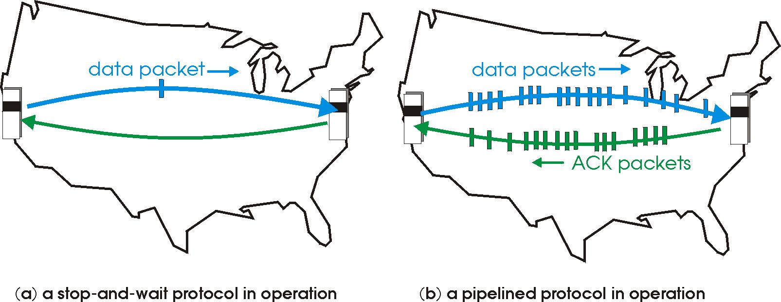

Pipelined protocols
pipelining: sender allows multiple, “in-flight”, yet-to-be-acknowledged pkts
range of sequence numbers must be increased
buffering at sender and/or receiver

Slide 33
Pipelining: increased utilization
sender
receiver
first packet bit transmitted, t = 0
last bit transmitted, t = L / R
first packet bit arrives
RTT
last packet bit arrives, send ACK
last bit of 2nd packet arrives, send ACK
last bit of 3rd packet arrives, send ACK
ACK arrives, send next
packet, t = RTT + L / R
3-packet pipelining increases
utilization by a factor of 3!
two generic forms of pipelined protocols: go-Back-N, selective repeat

Slide 34
Pipelined protocols: Go-back-N
sender can have up to N unacked packets in pipeline
receiver only sends cumulative ack
doesn’t ack packet if there’s a gap
sender has timer for oldest unacked packet
when timer expires, retransmit all unacked packets
Notes:
Cumulative ack means is ack 2 is lost but 4 is received then all from 2-4 should be considered receive

Slide 35
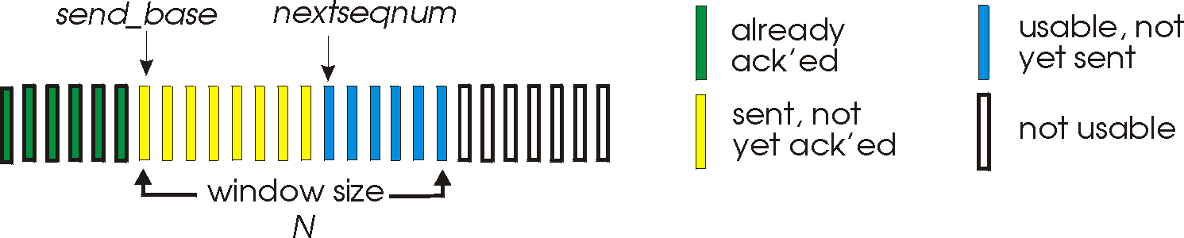
Go-Back-N: sender
k-bit seq # in pkt header
“window” of up to N, consecutive unack’ed pkts allowed
ACK(n): ACKs all pkts up to, including seq # n - “cumulative ACK”
may receive duplicate ACKs (see receiver)
timer for oldest in-flight pkt
timeout(n): retransmit packet n and all higher seq # pkts in window

Slide 36
GBN: sender extended FSM
rdt_send(data)
if (nextseqnum < base+N) {
sndpkt[nextseqnum] = make_pkt(nextseqnum,data,chksum)
udt_send(sndpkt[nextseqnum])
if (base == nextseqnum)
start_timer
nextseqnum++
}
else
refuse_data(data)
Λ
base=1
nextseqnum=1
timeout
Wait
start_timer
udt_send(sndpkt[base])
udt_send(sndpkt[base+1])
…
udt_send(sndpkt[nextseqnum-1])
rdt_rcv(rcvpkt)
&& corrupt(rcvpkt)
rdt_rcv(rcvpkt) &&
notcorrupt(rcvpkt)
base = getacknum(rcvpkt)+1
If (base == nextseqnum)
stop_timer
else
start_timer

Slide 37
GBN: receiver extended FSM
default
udt_send(sndpkt)
rdt_rcv(rcvpkt)
&& notcurrupt(rcvpkt)
&& hasseqnum(rcvpkt,expectedseqnum)
Λ
Wait
extract(rcvpkt,data)
deliver_data(data)
sndpkt = make_pkt(expectedseqnum,ACK,chksum)
udt_send(sndpkt)
expectedseqnum++
expectedseqnum=1
sndpkt =
make_pkt(expectedseqnum,ACK,chksum)
ACK-only: always send ACK for correctly-received pkt with highest in-order seq #
may generate duplicate ACKs
need only remember expectedseqnum
out-of-order pkt:
discard (don’t buffer): no receiver buffering!
re-ACK pkt with highest in-order seq #

Slide 38
GBN in action
sender window (N=4)
sender
receiver
0 1 2 3 4 5 6 7 8
send pkt0
send pkt1
send pkt2
send pkt3
(wait)
0 1 2 3 4 5 6 7 8
receive pkt0, send ack0
receive pkt1, send ack1
receive pkt3, discard,
(re)send ack1
0 1 2 3 4 5 6 7 8
X
0 1 2 3 4 5 6 7 8
loss
0 1 2 3 4 5 6 7 8
rcv ack0, send pkt4
rcv ack1, send pkt5
0 1 2 3 4 5 6 7 8
receive pkt4, discard,
(re)send ack1
ignore duplicate ACK
receive pkt5, discard,
(re)send ack1
pkt 2 timeout
0 1 2 3 4 5 6 7 8
send pkt2
send pkt3
send pkt4
send pkt5
0 1 2 3 4 5 6 7 8
0 1 2 3 4 5 6 7 8
rcv pkt2, deliver, send ack2
rcv pkt3, deliver, send ack3
rcv pkt4, deliver, send ack4
rcv pkt5, deliver, send ack5
0 1 2 3 4 5 6 7 8
For an interactive animation, visit:
https://media.pearsoncmg.com/aw/ecs_kurose_compnetwork_7/cw/content/interactiveanimations/go-back-n-protocol/index.html

Slide 39
Problems of GBN
For a large window size, a single packet error causes retransmission of a large number of packets
The pipeline becomes filled with unnecessary retransmissions
Can be solved by
accepting out of order packets by the receiver
selective retransmission
Selective Repeat (SR) protocol

Slide 40
Pipelined protocols: Selective repeat
sender can have up to N unack’ed packets in pipeline
receiver individually acknowledges all correctly received pkts
buffers pkts, as needed, for eventual in-order delivery to upper layer
sender only resends pkts for which ACK not received
sender timer for each unACKed pkt
sender window
N consecutive seq #’s
limits seq #s of sent, unACKed pkts

Slide 41
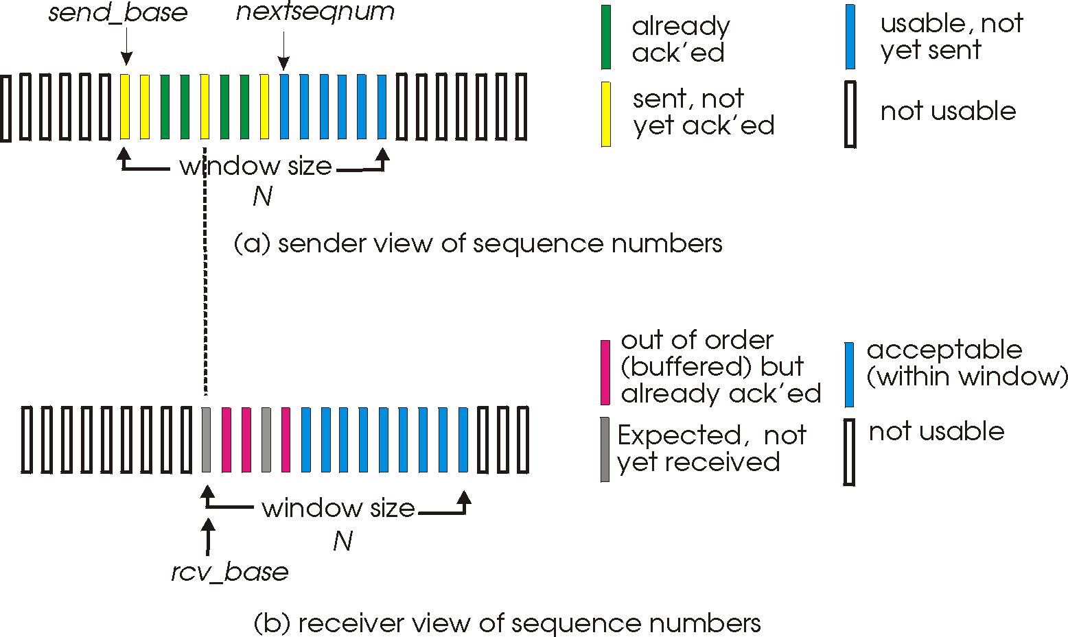
Selective repeat: sender, receiver windows

Slide 42
Selective repeat
sender
receiver
data from above:
if next available seq # in window, send pkt
timeout(n):
resend pkt n, restart timer
ACK(n) in [sendbase,sendbase+N]:
mark pkt n as received
if n smallest unACKed pkt, advance window base to next unACKed seq #
pkt n in [rcvbase, rcvbase+N-1]
send ACK(n)
out-of-order: buffer
in-order: deliver (also deliver buffered, in-order pkts), advance window to next not-yet-received pkt
pkt n in [rcvbase-N,rcvbase-1]
ACK(n)
otherwise:
ignore

Slide 43
Selective repeat in action
sender window (N=4)
sender
receiver
0 1 2 3 4 5 6 7 8
send pkt0
send pkt1
send pkt2
send pkt3
(wait)
0 1 2 3 4 5 6 7 8
receive pkt0, send ack0
receive pkt1, send ack1
receive pkt3, buffer,
send ack3
0 1 2 3 4 5 6 7 8
X
0 1 2 3 4 5 6 7 8
loss
0 1 2 3 4 5 6 7 8
rcv ack0, send pkt4
rcv ack1, send pkt5
0 1 2 3 4 5 6 7 8
receive pkt4, buffer,
send ack4
record ack3 arrived
receive pkt5, buffer,
send ack5
pkt 2 timeout
0 1 2 3 4 5 6 7 8
send pkt2
0 1 2 3 4 5 6 7 8
record ack4 arrived
0 1 2 3 4 5 6 7 8
rcv pkt2; deliver pkt2,
pkt3, pkt4, pkt5; send ack2
record ack4 arrived
0 1 2 3 4 5 6 7 8
Q: what happens when ack2 arrives?
For an interactive animation, visit:
https://media.pearsoncmg.com/aw/ecs_kurose_compnetwork_7/cw/content/interactiveanimations/selective-repeat-protocol/index.html

Slide 44

Problems with Finite Sequence No.
sender window
(after receipt)
receiver window
(after receipt)
0 1 2 3 0 1 2
pkt0
0 1 2 3 0 1 2
pkt1
0 1 2 3 0 1 2
example:
seq #’s: 0, 1, 2, 3
window size=3
0 1 2 3 0 1 2
pkt2
0 1 2 3 0 1 2
0 1 2 3 0 1 2
0 1 2 3 0 1 2
pkt3
X
0 1 2 3 0 1 2
pkt0
will accept packet
with seq number 0
receiver sees no difference in two scenarios!
duplicate data accepted as new in (b)
Q: what relationship between seq # size and window size to avoid problem in (b)?
Q: What should the relation in GBN?
(a) no problem
receiver can’t see sender side.
receiver behavior identical in both cases!
something’s (very) wrong!
0 1 2 3 0 1 2
pkt0
0 1 2 3 0 1 2
pkt1
0 1 2 3 0 1 2
0 1 2 3 0 1 2
pkt2
0 1 2 3 0 1 2
X
0 1 2 3 0 1 2
X
timeout
retransmit pkt0
X
0 1 2 3 0 1 2
pkt0
will accept packet
with seq number 0
(b) oops!

Slide 45
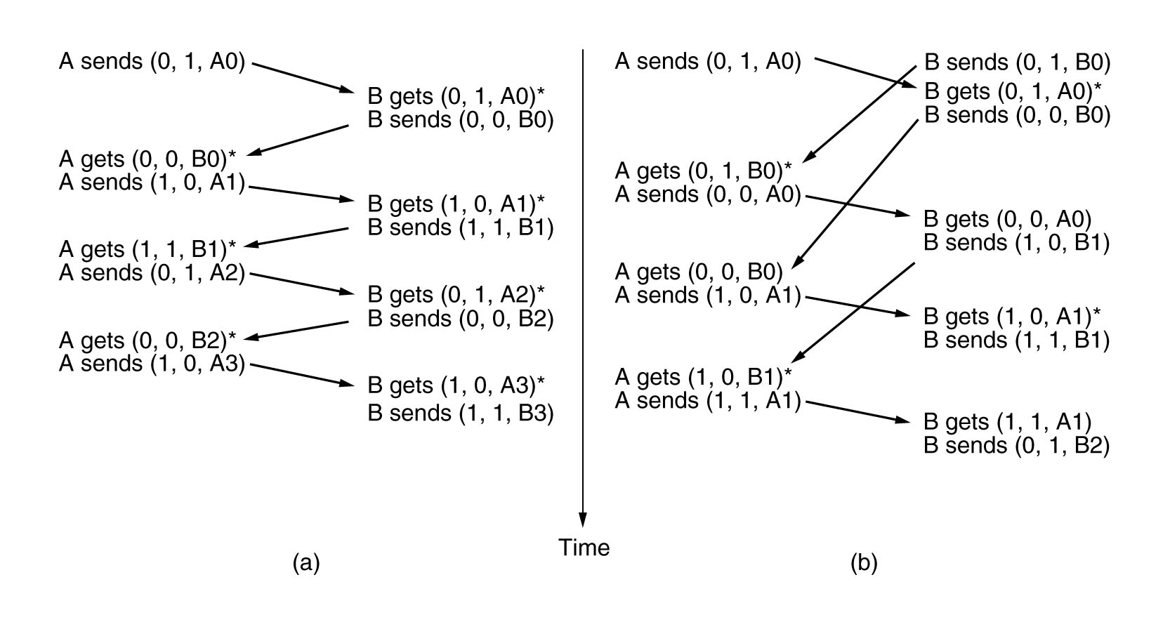
Bi-directional Transfer
Send ack in the same frame for data
Known as Piggybacking
Computer Networks, Fifth Edition by Andrew Tanenbaum and David Wetherall, © Pearson Education-Prentice Hall, 2011

Slide 46
Delayed Duplicate Problem
Old copies of a packet may appear at the sender or receiver
Since sequence numbers wrap around, care must be taken to guard against such duplicate packet
Do not use a sequence number, until all the earlier packets with the same sequence number have died out.
TCP extension for high speed network assumes maximum packet lifetime of approx. three minutes

Slide 47
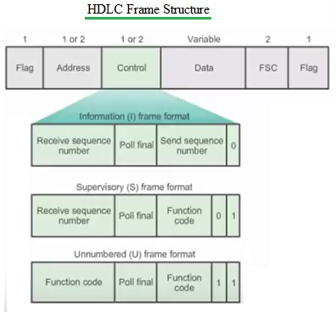
Sliding Window at Link Layer: HDLC

Slide 48
Sliding Window at Transport Layer: TCP
32 bits
URG: urgent data
(generally not used)
counting
by bytes
of data
(not segments!)
source port #
dest port #
sequence number
ACK: ACK #
valid
acknowledgement number
head
len
not
used
U
receive window
A
PSH: push data now
(generally not used)
P
R
S
F
# bytes
rcvr willing
to accept
checksum
Urg data pointer
RST, SYN, FIN:
connection estab
(setup, teardown
commands)
options (variable length)
application
data
(variable length)
Internet
checksum
(as in UDP)
TCP Header

Slide 49
Sliding Window in TCP (2)
outgoing segment from sender
sequence numbers:
byte stream “number” of first byte in segment’s data
acknowledgements:
seq # of next byte expected from other side
cumulative ACK
Q: how receiver handles out-of-order segments
A: TCP spec doesn’t say, - up to implementor
source port #
dest port #
sequence number
acknowledgement number
rwnd
checksum
urg pointer
window size
N
sender sequence number space
sent
ACKed
sent, not-yet ACKed
(“in-flight”)
usable
but not
yet sent
not
usable
incoming segment to sender
source port #
dest port #
sequence number
acknowledgement number
A
rwnd
checksum
urg pointer

Slide 50

TCP round trip time, timeout
timeout interval: EstimatedRTT plus “safety margin”
large variation in EstimatedRTT -> larger safety margin
estimate SampleRTT deviation from EstimatedRTT:
DevRTT = (1-β)*DevRTT +
β*|SampleRTT-EstimatedRTT|
(typically, β = 0.25)
TimeoutInterval = EstimatedRTT + 4*DevRTT
estimated RTT
“safety margin”

Slide 51
TCP ACK generation [RFC 1122, RFC 2581]
event at receiver
arrival of in-order segment with
expected seq #. All data up to
expected seq # already ACKed
arrival of in-order segment with
expected seq #. One other
segment has ACK pending
arrival of out-of-order segment
higher-than-expect seq. # .
Gap detected
arrival of segment that
partially or completely fills gap
TCP receiver action
delayed ACK. Wait up to 500ms
for next segment. If no next segment,
send ACK
immediately send single cumulative
ACK, ACKing both in-order segments
immediately send duplicate ACK,
indicating seq. # of next expected byte
immediate send ACK, provided that
segment starts at lower end of gap

Slide 52
TCP fast retransmit
time-out period often relatively long:
long delay before resending lost packet
detect lost segments via duplicate ACKs.
sender often sends many segments back-to-back
if segment is lost, there will likely be many duplicate ACKs.
TCP fast retransmit
if sender receives 3 ACKs for same data
(“triple duplicate ACKs”), resend unacked segment with smallest seq #
likely that unacked segment lost, so don’t wait for timeout
(“triple duplicate ACKs”),

Slide 53

TCP fast retransmit
Host A
Host B
Seq=92, 8 bytes of data
Seq=100, 20 bytes of data
X
ACK=100
timeout
ACK=100
ACK=100
ACK=100
Seq=100, 20 bytes of data
fast retransmit after sender
receipt of triple duplicate ACK

